Slide 1
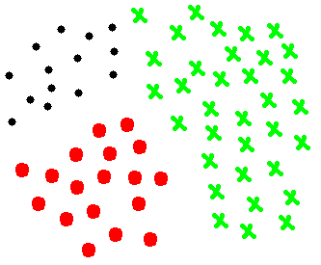
Addressing difficult classes by binarization
Alberto Fernández
Achieving a balanced accuracy among all classes via One-vs-One

Slide 2
Outline
Introduction
Binarization
Decomposition strategies (One-vs-One, One-vs-All and Others)
State-of-the-art on Aggregations
One-vs-One
One-vs-All
Difficult Classes
Introduction
Approaches to address this problem

Slide 3
Outline
Introduction
Binarization
Decomposition strategies (One-vs-One, One-vs-All and Others)
State-of-the-art on Aggregations
One-vs-One
One-vs-All
Difficult Classes
Introduction
Approaches to address this problem

Slide 4
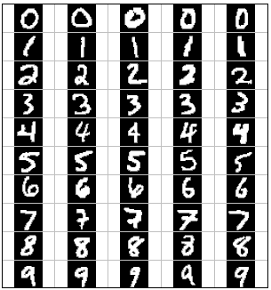
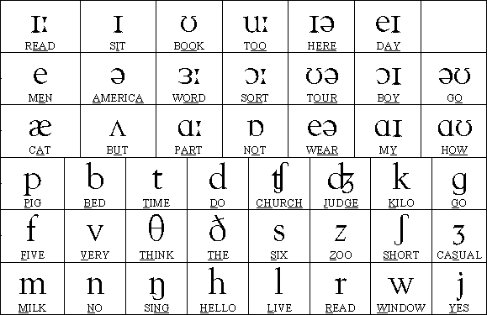
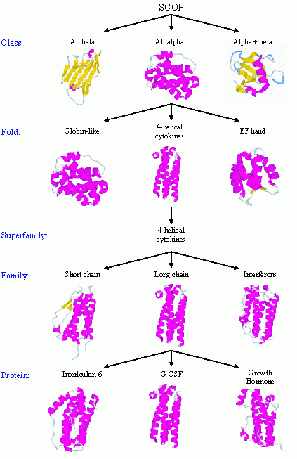
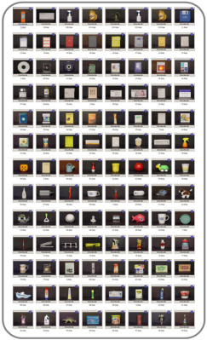
Introduction
Classification
2 class of classification problems:
Binary: medical diagnosis (yes / no)
Multicategory: Letter recognition (A, B, C…)
Binary problems are usually easier
Some classifiers do not support multiple classes
SVM, PDFC…
Digit recognition
Phoneme recognition
10
50
Automated protein classification
Object recognition
300-600
100

Slide 5
Introduction: Difficult Classes

Slide 6
Outline
Introduction
Binarization
Decomposition strategies (One-vs-One, One-vs-All and Others)
State-of-the-art on Aggregations
One-vs-One
One-vs-All
Difficult Classes
Introduction
Approaches to address this problem

Slide 7
Binarization
Decomposition of the multi-class problem
Divide and conquer strategy
Multi-class → Multiple easier to solve binary problems
For each binary problem
1 binary classifier = base classifier
Problem
How we should make the decomposition?
How we should aggregate the outputs?
Aggregation or Combination
Classifier_1
Classifier_i
Classifier_n
Final Output
Ensemble of classifiers

Slide 8
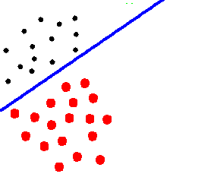
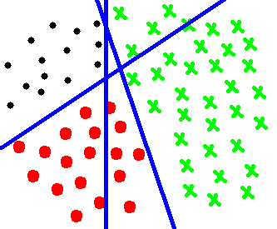
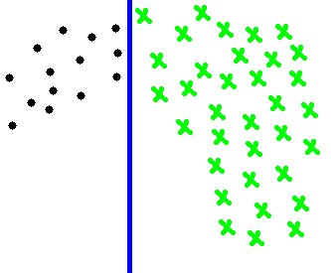
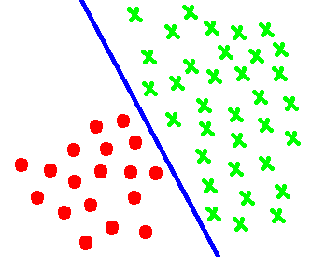
Decomposition Strategies
“One-vs-One” (OVO)
1 binary problem for each pair of classes
Pairwise Learning, Round Robin, All-vs-All…
Total = m(m-1) / 2 classifiers
Decomposition
Aggregation

Slide 9
One-vs-One
Advantages
Smaller (number of instances)
Simpler decision boundaries
Digit recognition problem by pairwise learning
linearly separable [Knerr90] (first proposal)
Parallelizable
…
[Knerr90] S. Knerr, L. Personnaz, G. Dreyfus, Single-layer learning revisited: A stepwise procedure for building and training a neural network, in: F. Fogelman Soulie, J. Herault (eds.), Neurocomputing: Algorithms, Architectures and Applications, vol. F68 of NATO ASI Series, Springer-Verlag, 1990, pp. 41–50.

Slide 10
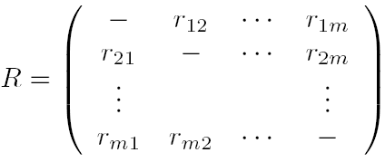
One-vs-One
Disadvantages
Higher testing times (more classifiers)
Non-competent examples [Fürnkranz06]
Many different aggregation proposals
Simplest: Voting strategy
Each classifier votes for the predicted class
Predicted = class with the largest nº of votes
[Fürnkranz06] J. Fürnkranz, E. Hüllermeier, S. Vanderlooy, Binary decomposition methods for multipartite ranking, in: W. L. Buntine, M. Grobelnik, D. Mladenic, J. Shawe-Taylor (eds.), Machine Learning and Knowledge Discovery in Databases, vol. 5781(1) of LNCS, Springer, 2006, pp. 359–374.

Slide 11
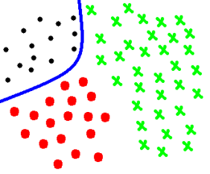
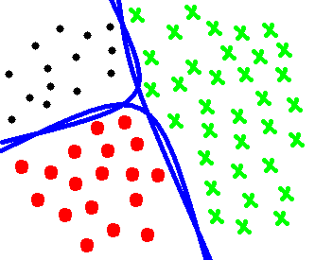
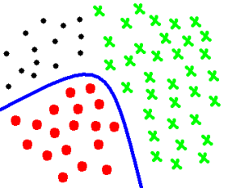
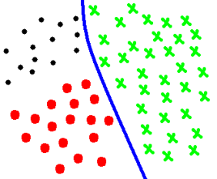
Decomposition Strategies
“One-vs-All” (OVA)
1 binary problem for each class
All instances in each problem
Positive class: instances from the class considered
Negative class: instances from all other classes
Total = m classifiers
Aggregation
Decomposition

Slide 12
One-vs-All
Advantages
Less nº of classifiers
All examples are “competent”
Disadvantages
Less studied in the literature
low nº of aggregations
Simplest: Maximum confidence rule (max(rij))
More complex problems
Imbalance training sets

Slide 13
Decomposition Strategies
Hierarchical approaches
Distinguish groups of classes in each nodes
Examples:
Decision Directed Acyclic Graph (DDAG)
Binary Tree of Classifiers
Nesting One-vs-One
Cascade classifiers
Ensemble of classifiers, one specific per pair of classes.

Slide 14
Outline
Introduction
Binarization
Decomposition strategies (One-vs-One, One-vs-All and Others)
State-of-the-art on Aggregations
One-vs-One
One-vs-All
Difficult Classes
Introduction
Approaches to address this problem

Slide 15
Combination of the outputs
Aggregation phase
The way in which the outputs of the base classifiers are combined to obtain the final output.
Key-factor in OVO and OVA ensembles
Ideally, voting and max confidence works
In real problems
Contradictions between base classifiers
Ties
Base classifiers are not 100% accurate
…

Slide 16
State-of-the-art on aggregation for OVO
Starting from the score-matrix
rij = confidence of classifier in favor of class i
rji = confidence of classifier in favor of class j
Usually: rji = 1 – rij (required for probability estimates)

Slide 17
State-of-the-art on aggregation for OVO
Voting strategy (VOTE) [Friedman96]
Each classifier gives a vote for the predicted class
The class with the largest number of votes is predicted
where s_{ij} is 1 if r_{ij} > r_{ji} and 0 otherwise.
Weighted voting strategy (WV)
WV = VOTE but weight = confidence
[Friedman96] J. H. Friedman, Another approach to polychotomous classification, Tech. rep., Department of Statistics, Stanford University (1996).

Slide 18
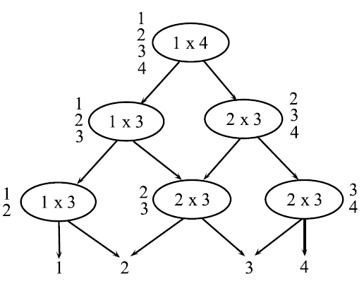
State-of-the-art on aggregation for OVO
Decision Directed Acyclic Graph (DDAG) [Platt00]
Constructs a rooted binary acyclic graph
Each node is associated to a list of classes and a binary classifier
In each level a classifier discriminates between two classes
The class which is not predicted is removed
The last class remaining on the list is the final output class.
[Platt00] J. C. Platt, N. Cristianini and J. Shawe-Taylor, Large Margin DAGs for Multiclass Classification, Proc. Neural Information Processing Systems (NIPS’99), S.A. Solla, T.K. Leen and K.-R. Müller (eds.), (2000) 547-553.

Slide 19
State-of-the-art on aggregation for OVO
Binary Tree of Classifiers (BTC)
From Binary Tree of SVM [Fei06]
Reduce the number of classifiers
Idea: Some of the binary classifiers which discriminate between two classes
Also can distinguish other classes at the same time
Tree constructed recursively
Similar to DDAG
Each node: class list + classifier
More than 1 class can be deleted in each node
To avoid false assumptions: probability threshold for examples from other classes near the decision boundary
[Fei06] B. Fei and J. Liu. Binary tree of SVM: a new fast multiclass training and classification algorithm. IEEE Transactions on Neural Networks, 17(3):696–704, 2006

Slide 20
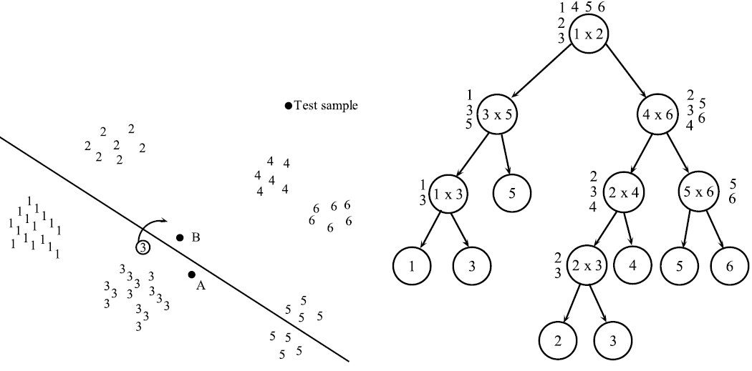
State-of-the-art on aggregation for OVO
BTC for a six class problem
Classes 3 and 5 are assigned to two leaf nodes
Class 3 by reassignment (probability threshold)
Class 5 by the decision function between class1 and 2

Slide 21
State-of-the-art on aggregation for OVO
Nesting One-vs-One (NEST) [Liu07,Liu08]
Tries to tackle the unclassifiable produced by VOTE
Use VOTE
But if there are examples within the unclassifiable region
Build a new OVO system only with the examples in the region in order to make them classifiable
Repeat until no examples remain in the unclassifiable region
The convergence is proved
No maximum nested OVOs parameter
[Liu07] Z. Liu, B. Hao and X. Yang. Nesting algorithm for multi-classification problems. Soft Computing, 11(4):383–389, 2007.
[Liu08] Z. Liu, B. Hao and E.C.C. Tsang. Nesting one-against-one algorithm based on SVMs for pattern classification. IEEE Transactions on Neural Networks, 19(12):2044–2052, 2008.

Slide 22
Outline
Introduction
Binarization
Decomposition strategies (One-vs-One, One-vs-All and Others)
State-of-the-art on Aggregations
One-vs-One
One-vs-All
Difficult Classes
Introduction
Approaches to address this problem

Slide 23
State-of-the-art on aggregation for OVA
Starting from the score-vector
ri = confidence of classifier in favor of class i
Respect to all other classes
Usually more than 1 classifier predicts the positive class
Tie-breaking techniques

Slide 24
State-of-the-art on aggregation for OVA
Maximum confidence strategy (MAX)
Predicts the class with the largest confidence
Dynamically Ordered One-vs-All (DOO) [Hong08]
It is not based on confidences
Train a Naïve Bayes classifier
Use its predictions to Dynamically execute each OVA
Predict the first class giving a positive answer
Ties avoided a priori by a Naïve Bayes classifier
[Hong08] J.-H. Hong, J.-K. Min, U.-K. Cho, and S.-B. Cho. Fingerprint classification using one-vs-all support vector machines dynamically ordered with naïve bayes classifiers. Pattern Recognition, 41(2):662–671, 2008.

Slide 25
Outline
Introduction
Binarization
Decomposition strategies (One-vs-One, One-vs-All and Others)
State-of-the-art on Aggregations
One-vs-One
One-vs-All
Difficult Classes
Introduction
Approaches to address this problem

Slide 26
Difficult Classes in OVO Strategy

Slide 27
Difficult Classes in OVO Strategy

Slide 28
Difficult Classes in OVO Strategy

Slide 29
Definición de clases difíciles
Respecto a su representación en el problema,
Medidas de complejidad de datos asociadas,
Precisión obtenida por un clasificador genérico,
Cualquier otra metodología similar…

Slide 30
Medidas para este escenario
Accuracy: no aporta información sobre la calidad en las distintas clases del problema.
Kappa: no llega a instaurarse y causa controversia.
Propuestas:
Uso de un accuracy ponderado
Independiente de la distribución de ejemplos
Dependiente de la distribución de ejemplos
Media geométrica multi-clase
AUC multi-clase

Slide 31
Outline
Introduction
Binarization
Decomposition strategies (One-vs-One, One-vs-All and Others)
State-of-the-art on Aggregations
One-vs-One
One-vs-All
Difficult Classes
Introduction
Approaches to address this problem

Slide 32
Modelos de actuación
Esquemas que alteran el comportamiento de la estrategia OVO para beneficiar a las clases difíciles.
Tratamiento de clasificadores no competentes,
Aplicar esquemas que manejen la clasificación no balanceada.
Ponderar la salida a posteriori para beneficiar clases “difíciles” [Galar14]
M, Galar, A. Fernandez, E. Barrenechea, F. Herrera. Empowering difficult classes with a Similarity-based aggregation in multi-class classification problems. Information Sciences 264 (2014) 135-157. doi: 10.1016/j.ins.2013.12.053

Slide 33
Modelos de actuación (2)
Trabajar sobre problemas intrínsecos:
Solapamiento: uso de la medida F1
Descubrimiento y tratamiento de los “pequeños datos disjuntos”: uso de esquemas de clustering para mejorar la densidad de datos

Slide 34
Propuestas iniciales
Desarrollar soluciones concretas a nivel algorítmico que apliquen una metodología de aprendizaje orientada a gestionar los problemas anteriormente citados,
Realizar modelos sobre ensembles de clasificadores, aprovechando las ventajas ofrecidas por este tipo agregación de métodos.
Trabajar con limpieza de datos a nivel de instancias y variables: Aplicar “ponderación de instancias” en lugar de hacer una simple y tradicional “selección”.
“Selección de instancias” puede resultar agresiva eliminando ejemplos.
Diseñar un modelo que “fortifique” o de importancia a las instancias claves del problema asignándoles un coste.
En concreto, estas instancias deberán ser aquéllas que estén rodeadas por muchas de la clase contraria (serían “small disjuncts” o “borderline”)
pero que asimismo tengan una representación adecuada en su área del problema: ni ruido ni outliers.

Slide 35
Tratamiento de clases difíciles
Utilizar aprendizaje sensible al coste una vez definidos los conceptos del problema en los que prestar mayor atención.
Uso de técnicas sofisticadas para equilibrar en lo posible la precisión global y evitar bias hacia las clases “difíciles”.
Correcta gestión durante el proceso de decisión en el esquema OVO.
Nuevas técnicas de agregación o adaptación de las ya existentes
Agrupación óptima de las clases para realizar mejor la labor de aprendizaje en la binarización.
Basado en esquemas de “competición”, o uso de modelo mixto OVA-OVO para discriminar mejor grupos de clases similares.

Slide 36
¿Preguntas?
¡Gracias por vuestra atención!

